Slide 1
NBA Players Clustering
Getting the data was a very lengthy process
Data taken directly from NBA.com through API
Data from different stats tables for 7 seasons to get more precise stats for players (2015-16 to 2021-22)

Slide 2
Data Cleaning
Original Dataset: 1161 observations with 183 features.
Discarded some observations where the minutes played per game or total games played for the 7 seasons were insignificant.
Reduced the number of Observations from 1161 to 560.

Slide 3
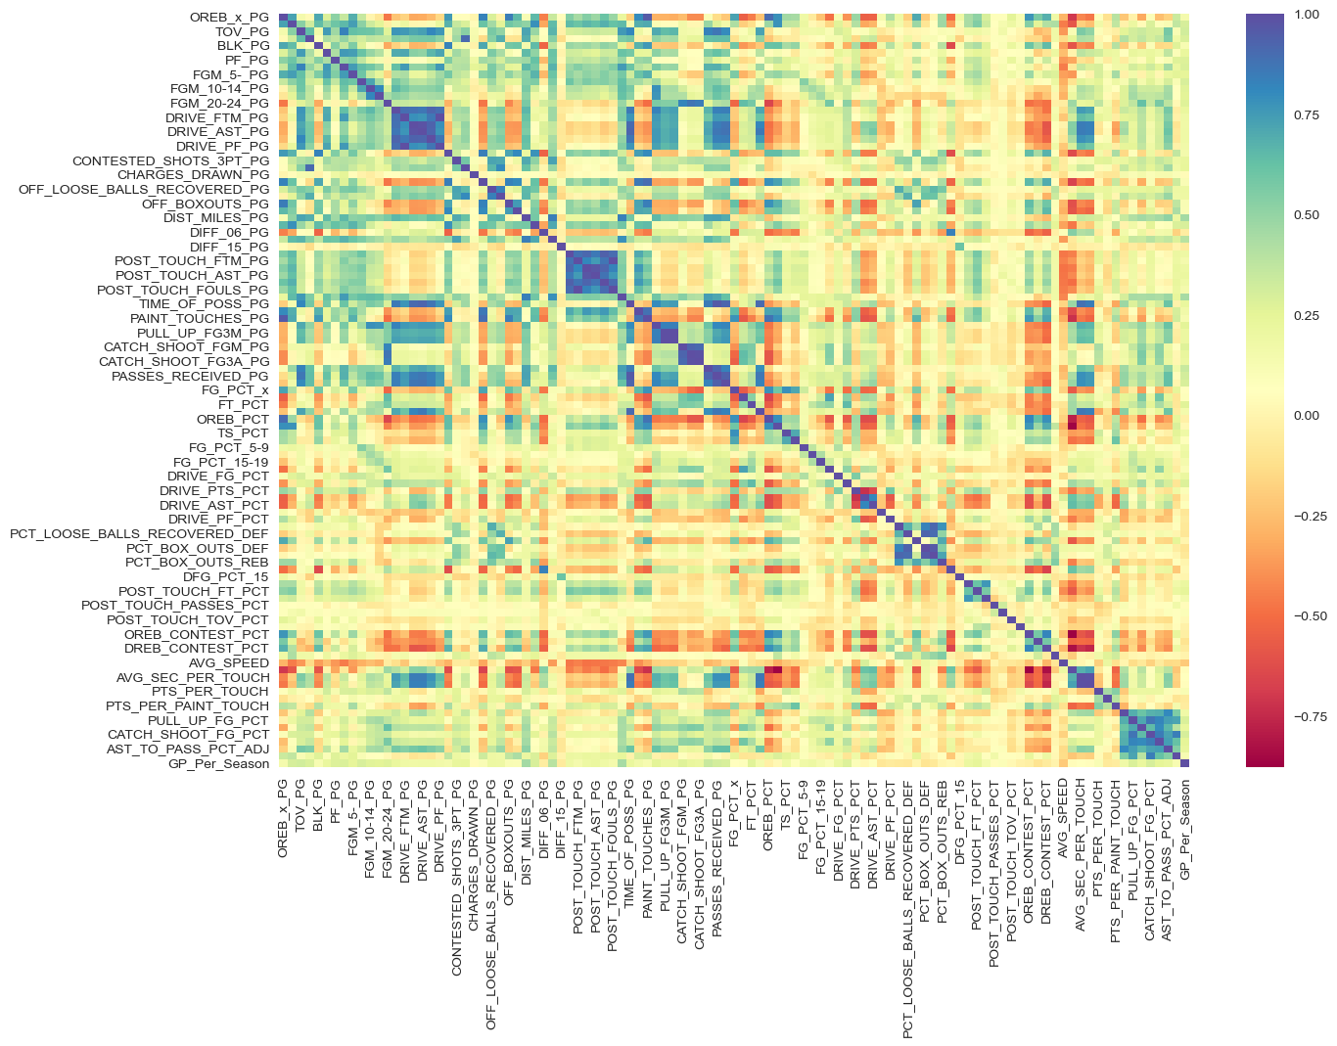
Feature Selection
Feature Selection using Variance Inflation Factor, Heatmap correlation, and LOTS of Googling!
Reduced the number of Features from 183 to 105.

Slide 4
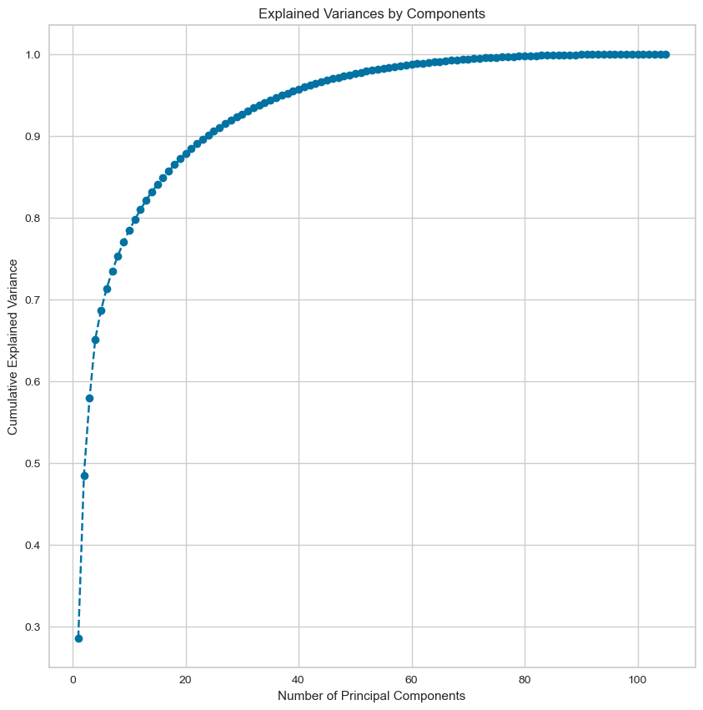
Dimensionality Reduction
Dimensionality Reduction using PCA to visualize the data in lower dimensions (2D)
Number of PCs that explain at least 65% variance in the data: 4
Used the First 5 Principal Components for clustering models as it explains close to 70% of variance in data

Slide 5
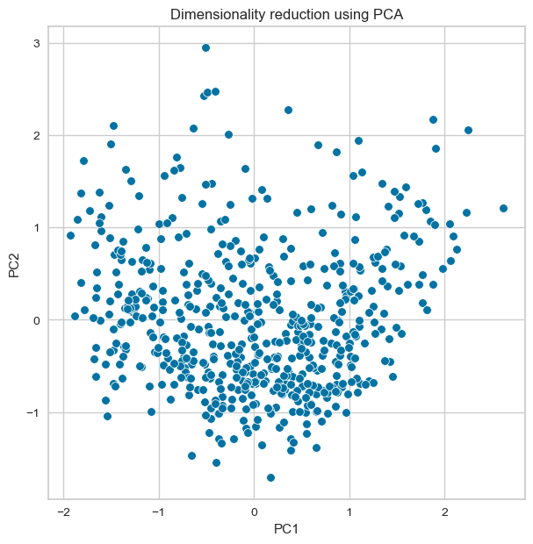
PCA using PC1 and PC2

Slide 6
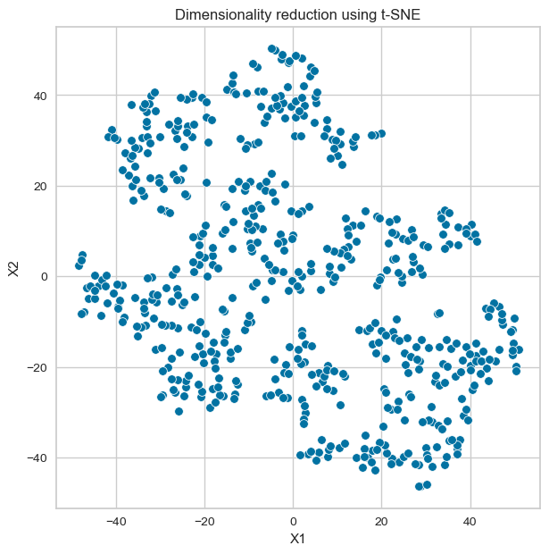
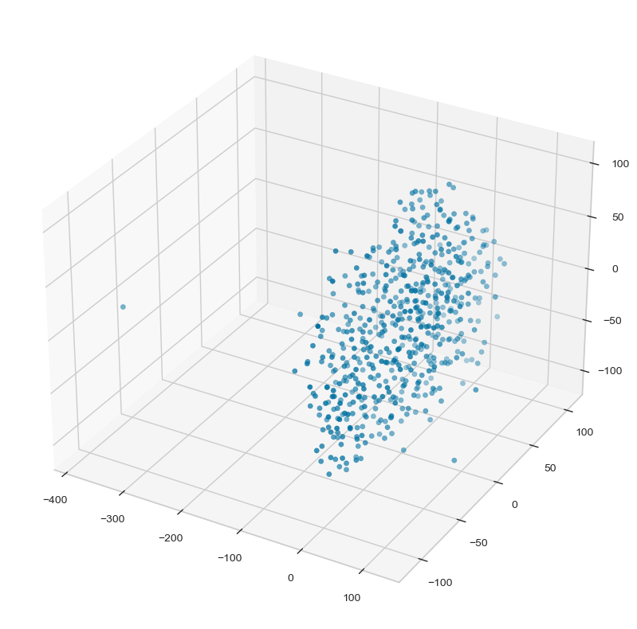
Dimensionality Reduction using t-SNE to visualize the data in lower dimensions (2D and 3D)

Slide 7
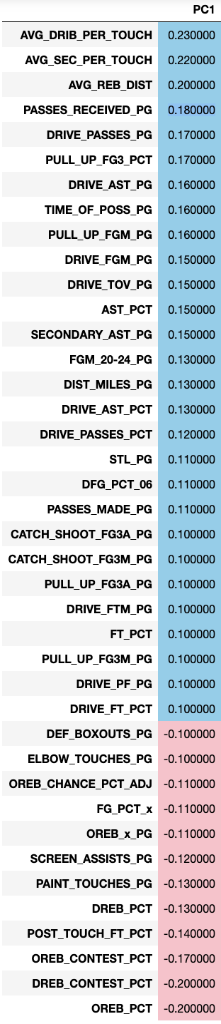
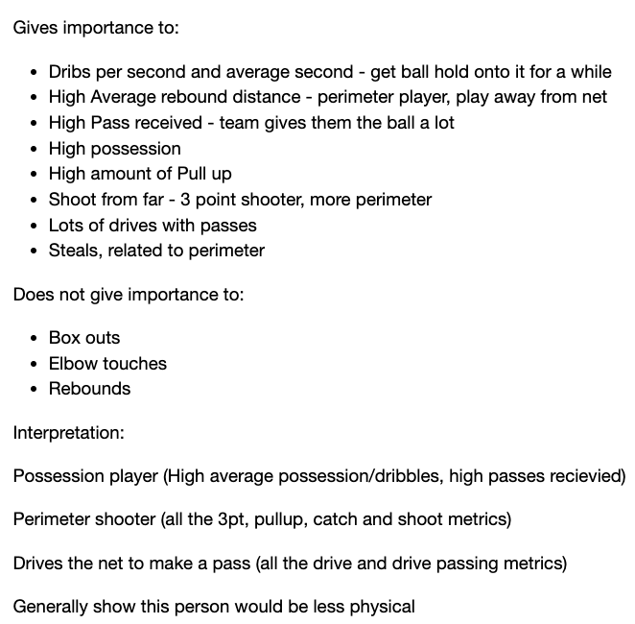
Interpretation on the Principal Component 1

Slide 8
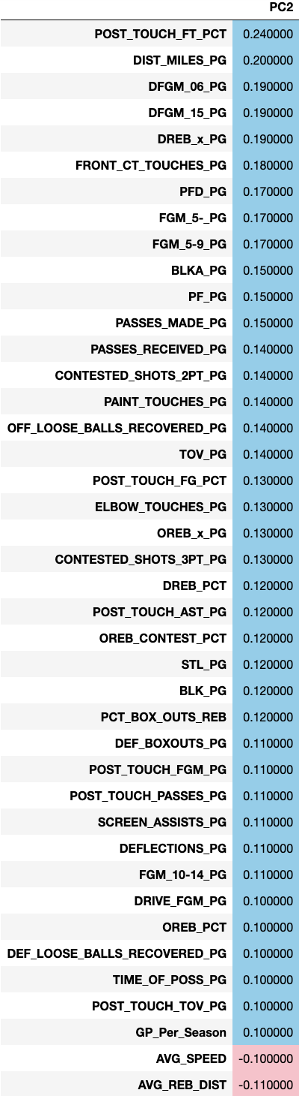
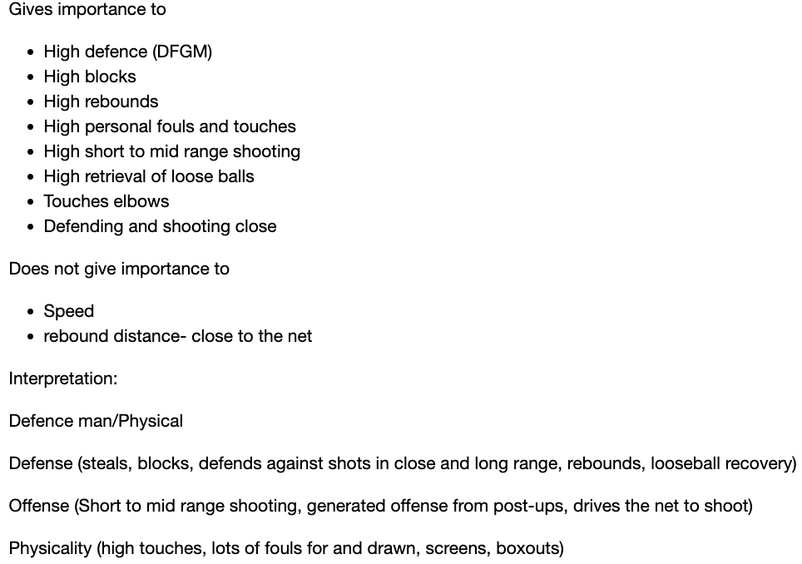
Interpretation on the Principal Component 2

Slide 9
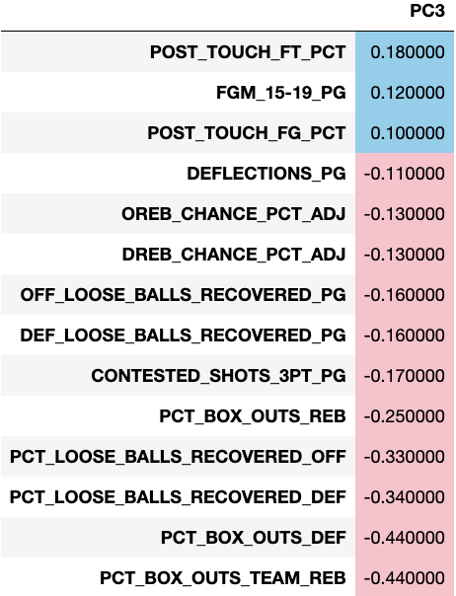
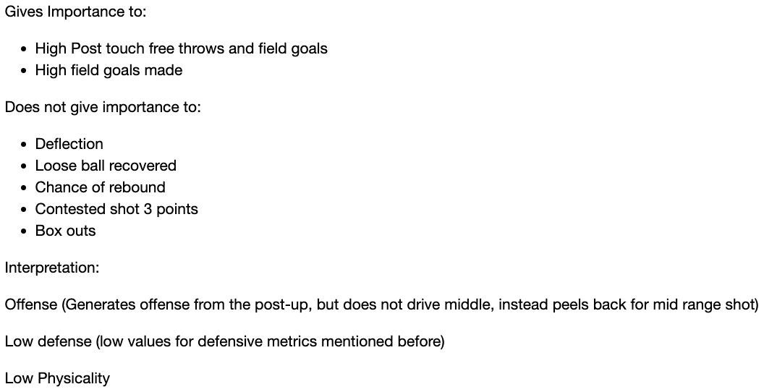
Interpretation on the Principal Component 3

Slide 10
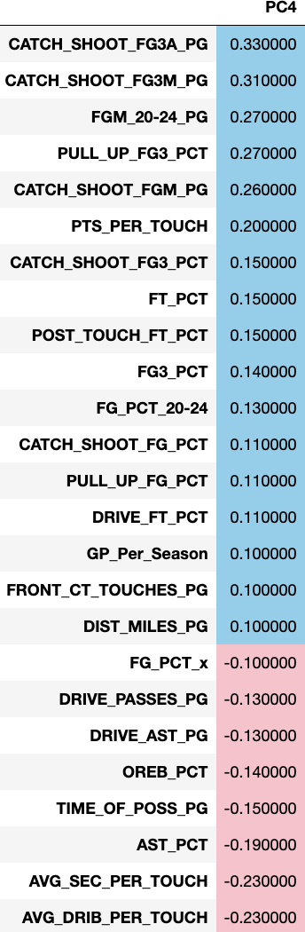
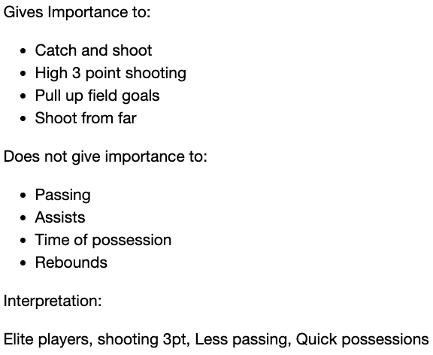
Interpretation on the Principal Component 4

Slide 11
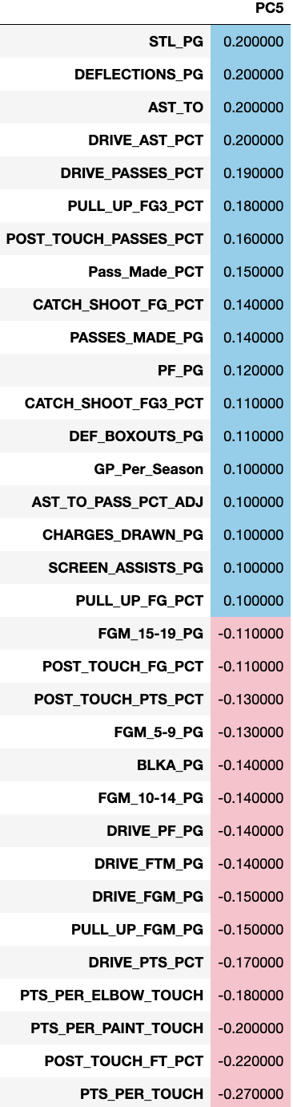
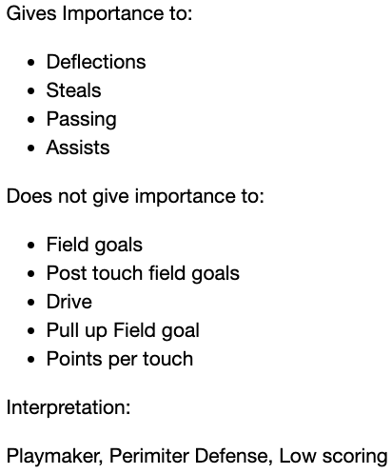
Interpretation on the Principal Component 5

Slide 12
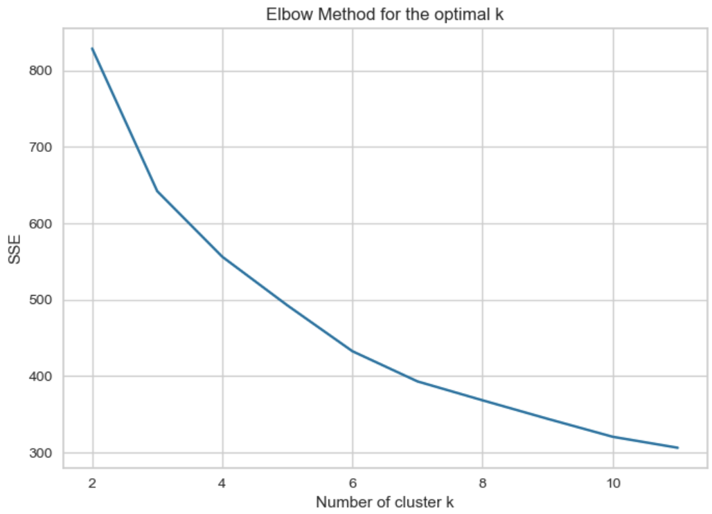
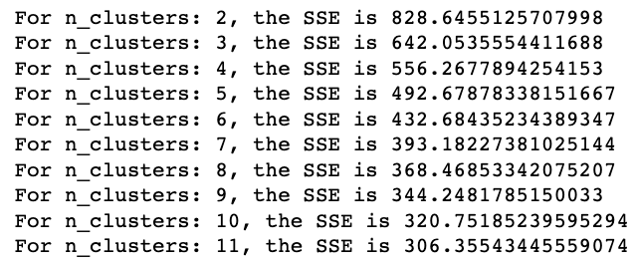
Elbow plot for optimal number of clusters
Cannot get much information from the Elbow plot since we cannot see a clear sharp drop in Sum of Squared Errors, except for 3 clusters, but not much additional insight can be drawn from 3 clusters

Slide 13
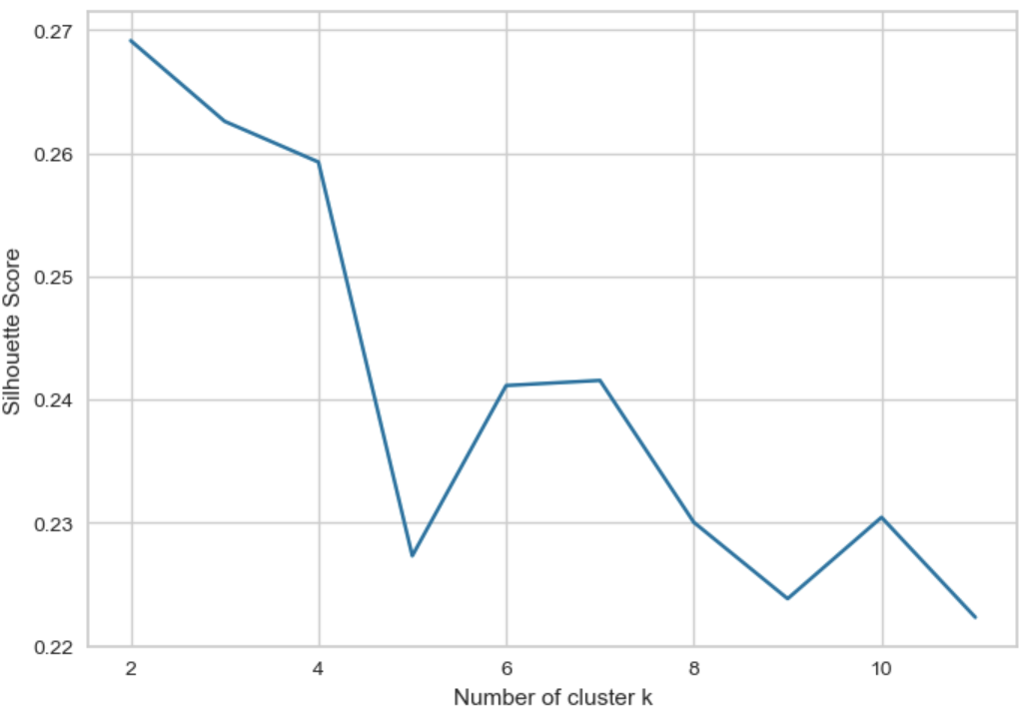
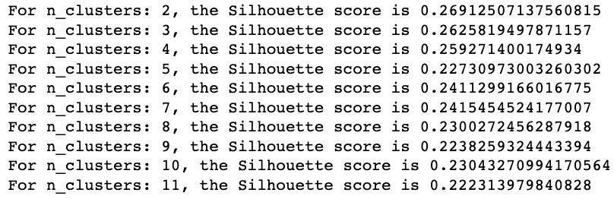
Silhouette Plot for the optimal number of clusters
Silhouette scores were similar for 6 and 7 clusters. However, after trying both, we observed that 6 clusters gave better cluster separation despite the slightly lower Silhouette score as the tail in the negative is very small

Slide 14
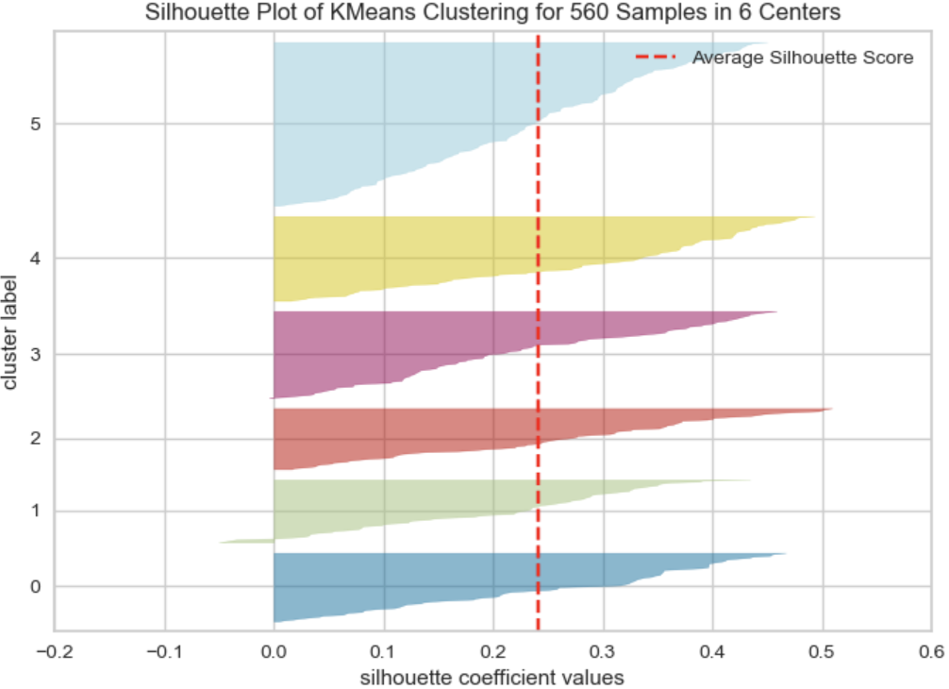
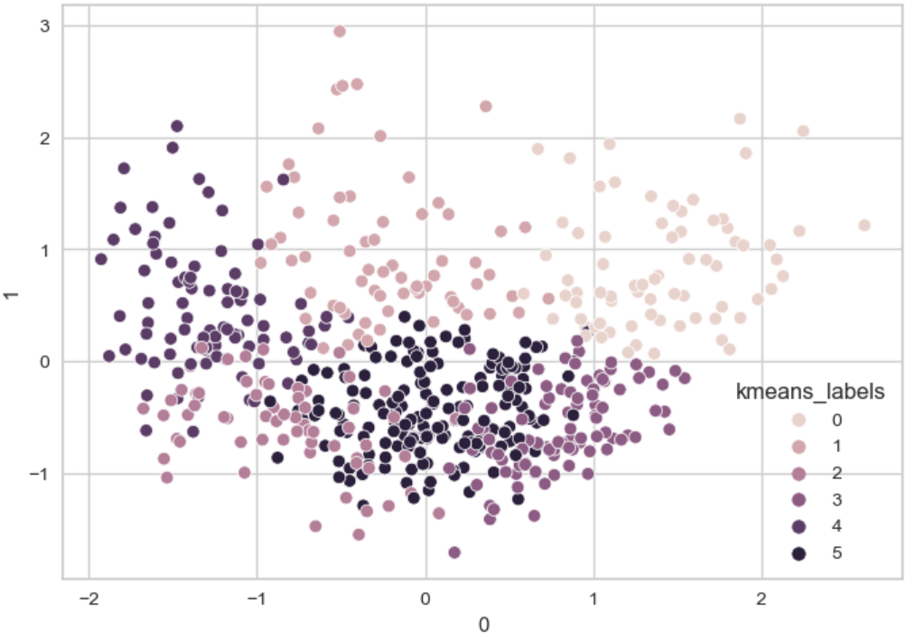
K-Means
Kmeans with 6 clusters

Slide 15
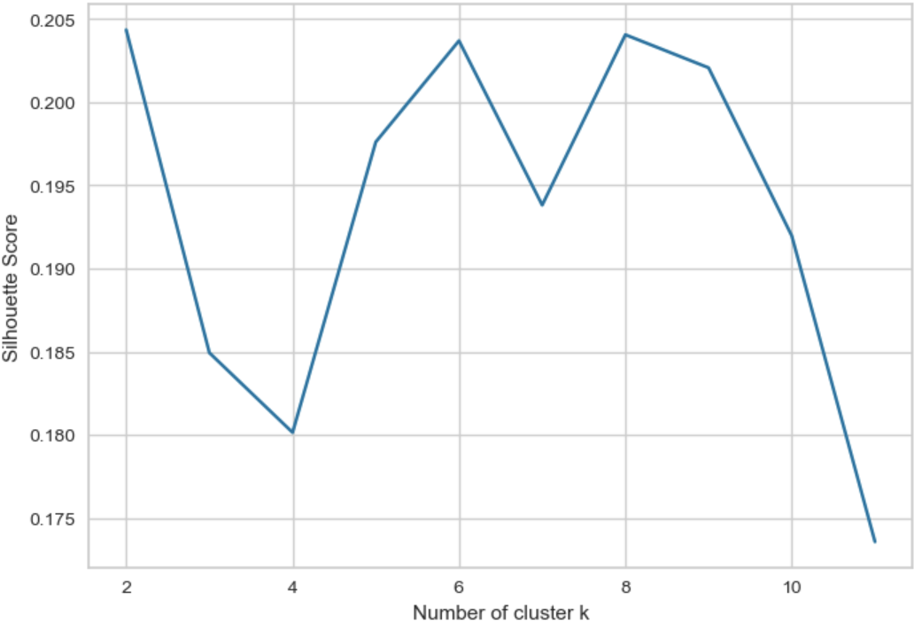
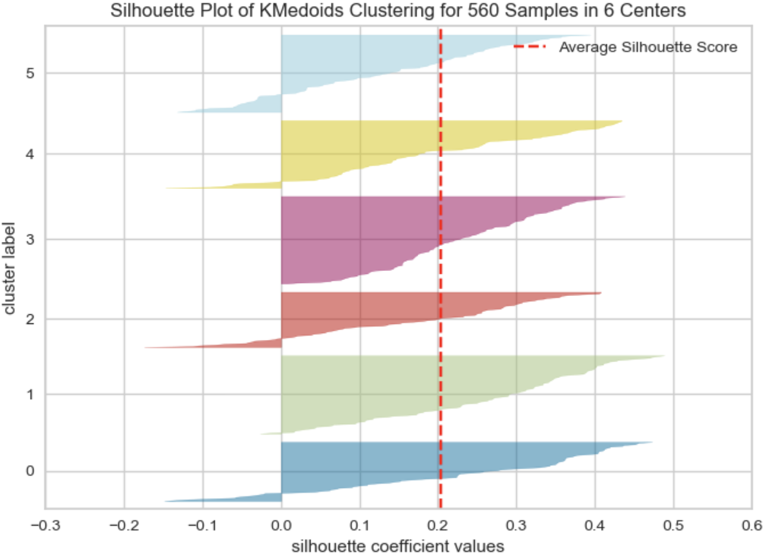
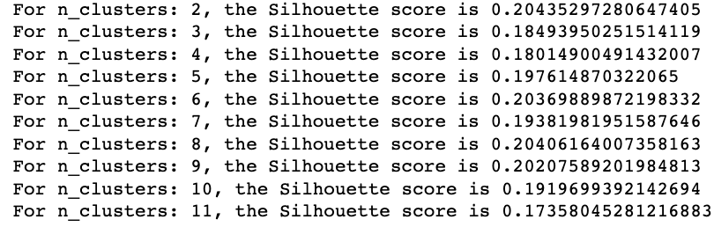
K-Medoids
KMedoids with 6 clusters

Slide 16
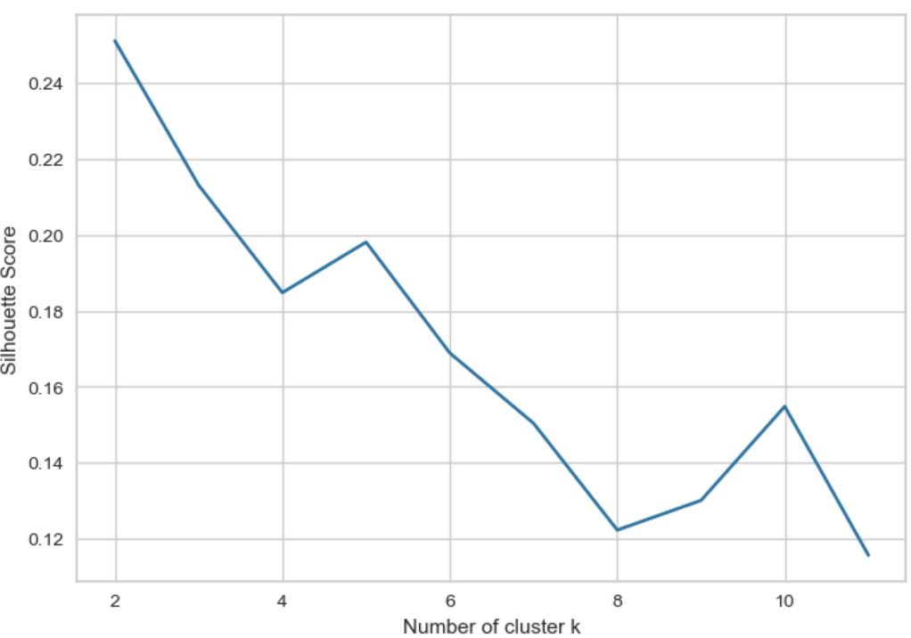
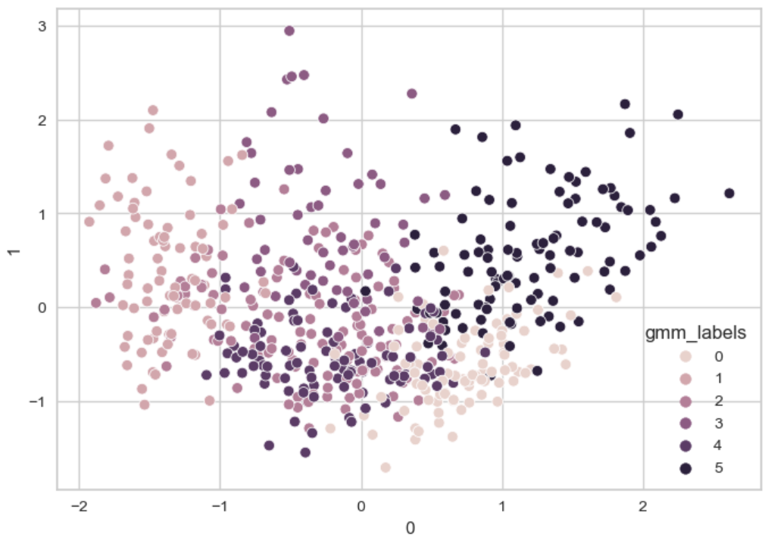
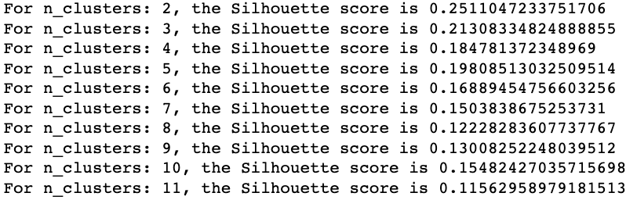
Gaussian Mixture Model (GMM)
GMM with 6 clusters – lots of overlap

Slide 17
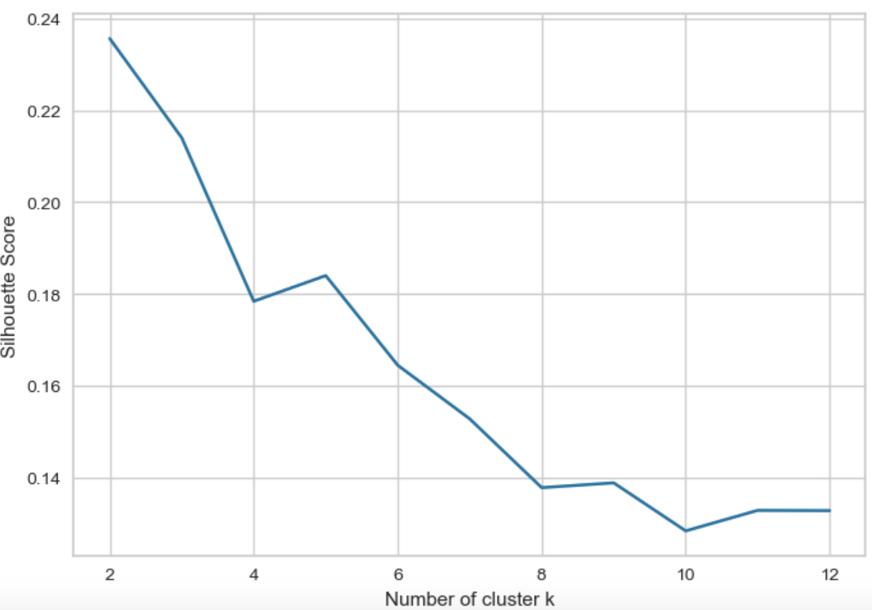
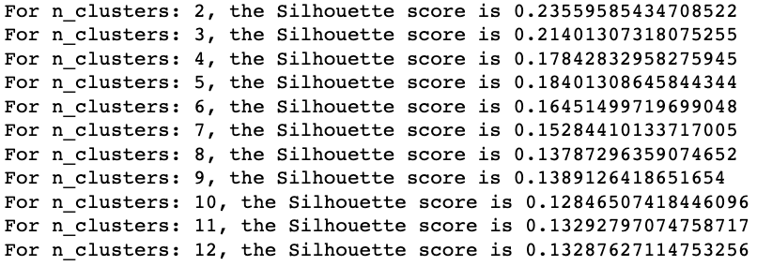
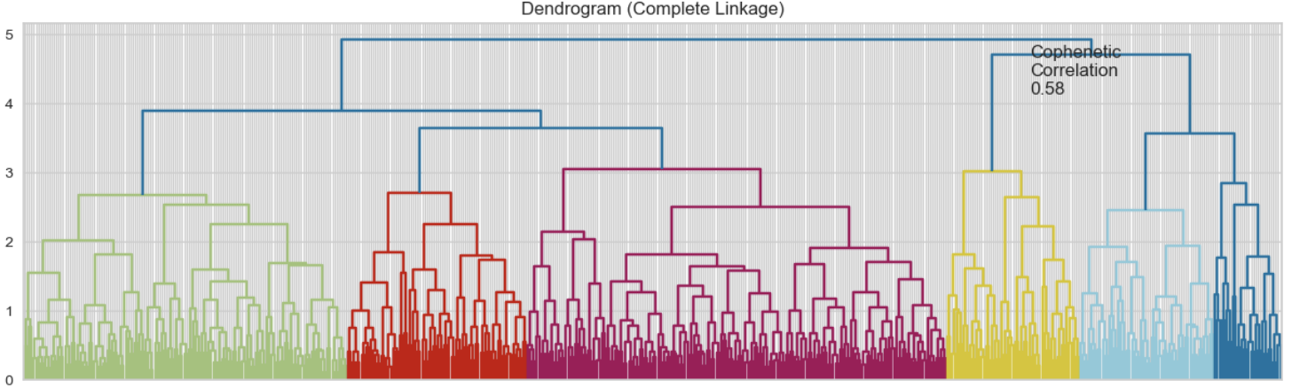
Hierarchical - Agglomerative Clustering
Tried different distance metrics and linkage methods.
Best cluster separation with euclidean distance and complete linkage.

Slide 18
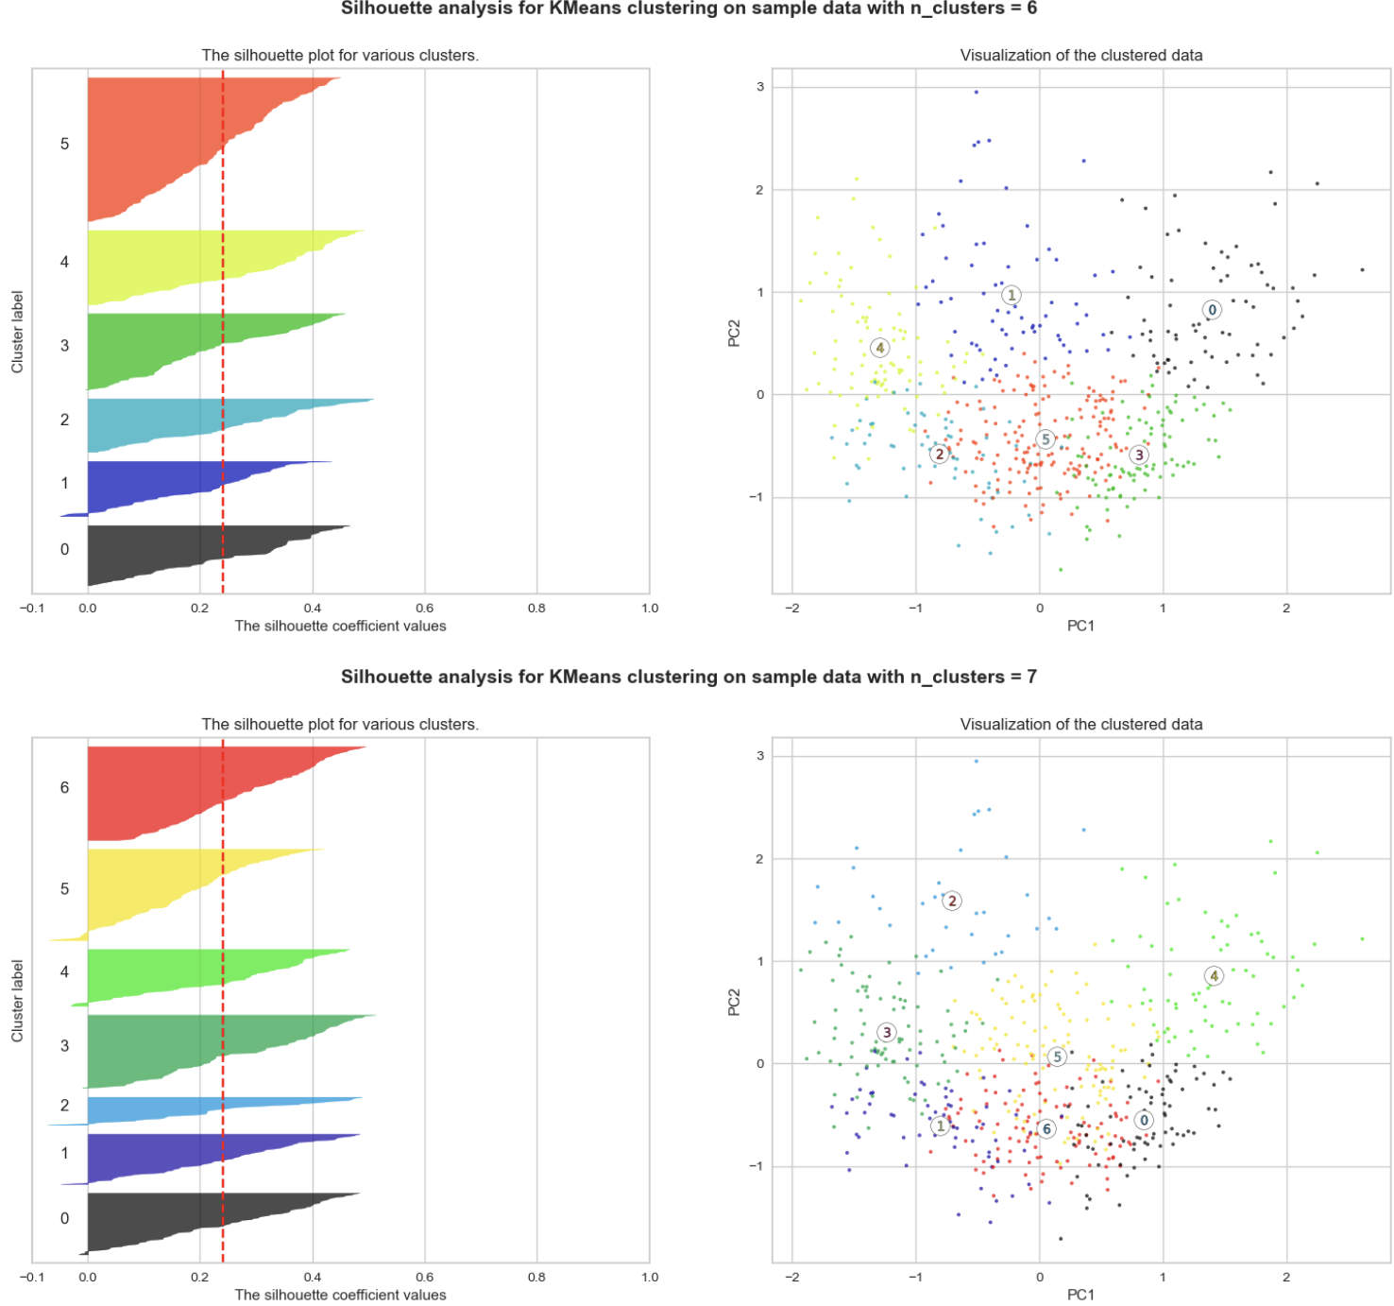
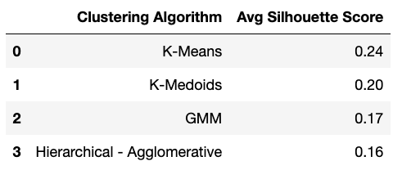
Comparison of Silhouette Scores

Slide 19
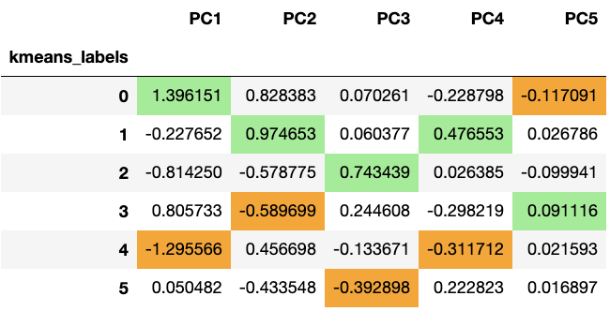
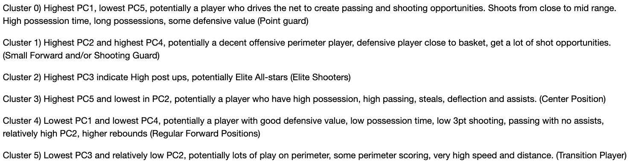
Interpretation of clusters

Slide 20
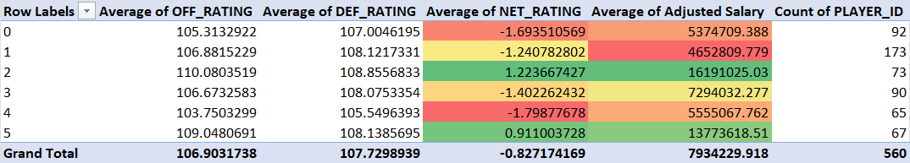
Clusters in terms of their Salaries
Transition/all-around players (C5) and Power-Forwards/elite scorers (C2) provide the most overall value to the team and their pay
reflects this
Point Guards (C0) and Regular Forwards (C4) both provide worse offence and better defence than the other forward categories,
but their pay does not match their lower
Centers (C3) seem to be paid what they are worth.
Our Small Forwards and Shooting Guards are underpaid. Interesting to note that the most underpaid cluster is also the cluster with
the most # of players, potentially indicating that their services are not as scarce like other roles, and that both "overpaid" clusters
have the best defence (contrary to our expectations)

